Slide 1
Logistics and Shipping Hub
Group Number-14
Shivdeep Bisurkar A20525712
Prajakta Kumbhar A20523710
Pavani Rangineni A20516359

Slide 2

Introduction
The primary focus of this project is to create a user-friendly digital interface that seamlessly connects businesses and individuals with logistics and shipping providers.
Users can Explore, choose, and manage their logistics needs effortlessly, all in one place..

Slide 3
Technology Stack
Business Logic
MySQL
MongoDB
Database
User Interface
React
Node.js

Slide 4
Functionalities
User Registration and Profile Management
Service Search and Selection
Service Provider Directory
Coverage Area Mapping
Service Customization
Real-Time Shipment Tracking
Secure Payments
Natural Language Interaction(chatbot)
Dynamic Recommendations
Feedback Mechanism
Analytics & Visual Reports
Auto-Complete Products/Services Search

Slide 5
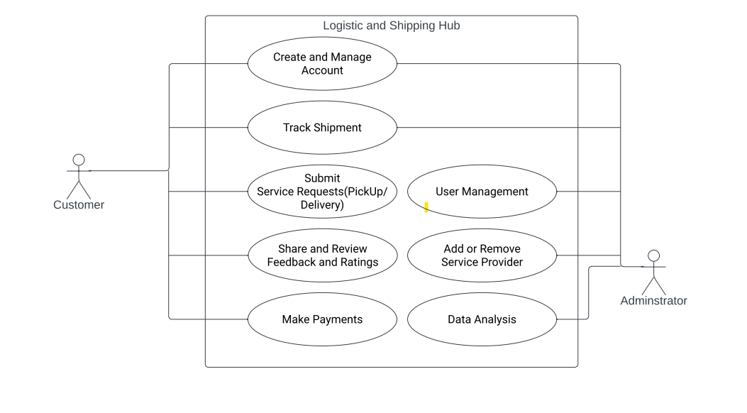
Use Case Diagram

Slide 6
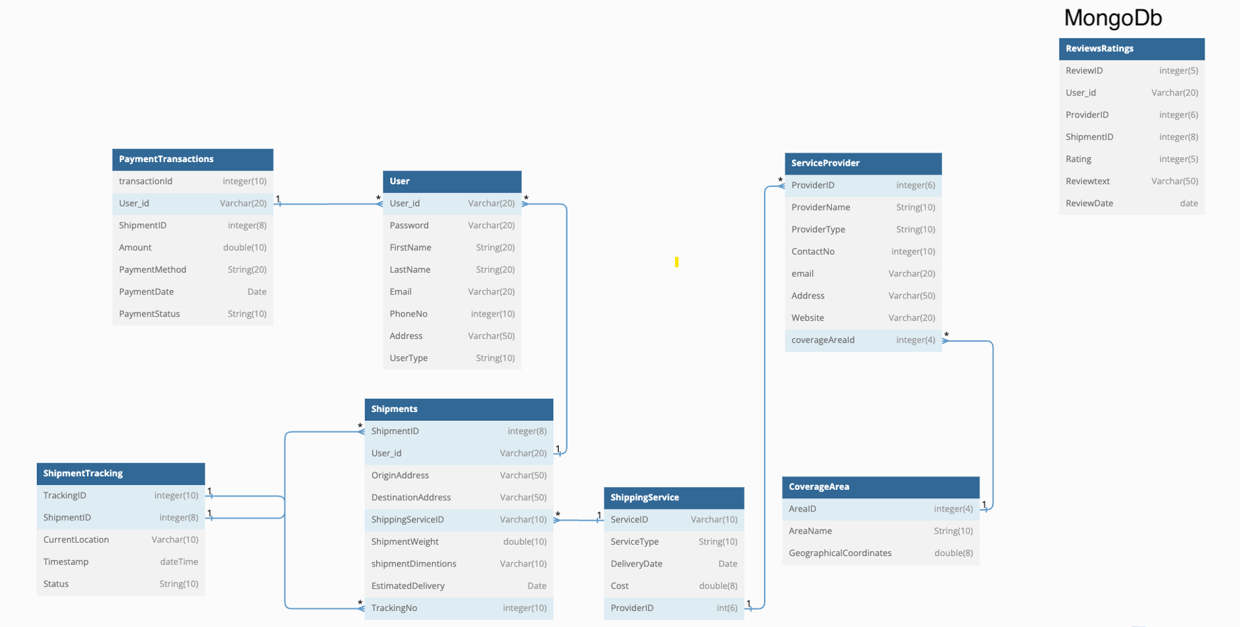
Database Schema

Slide 7
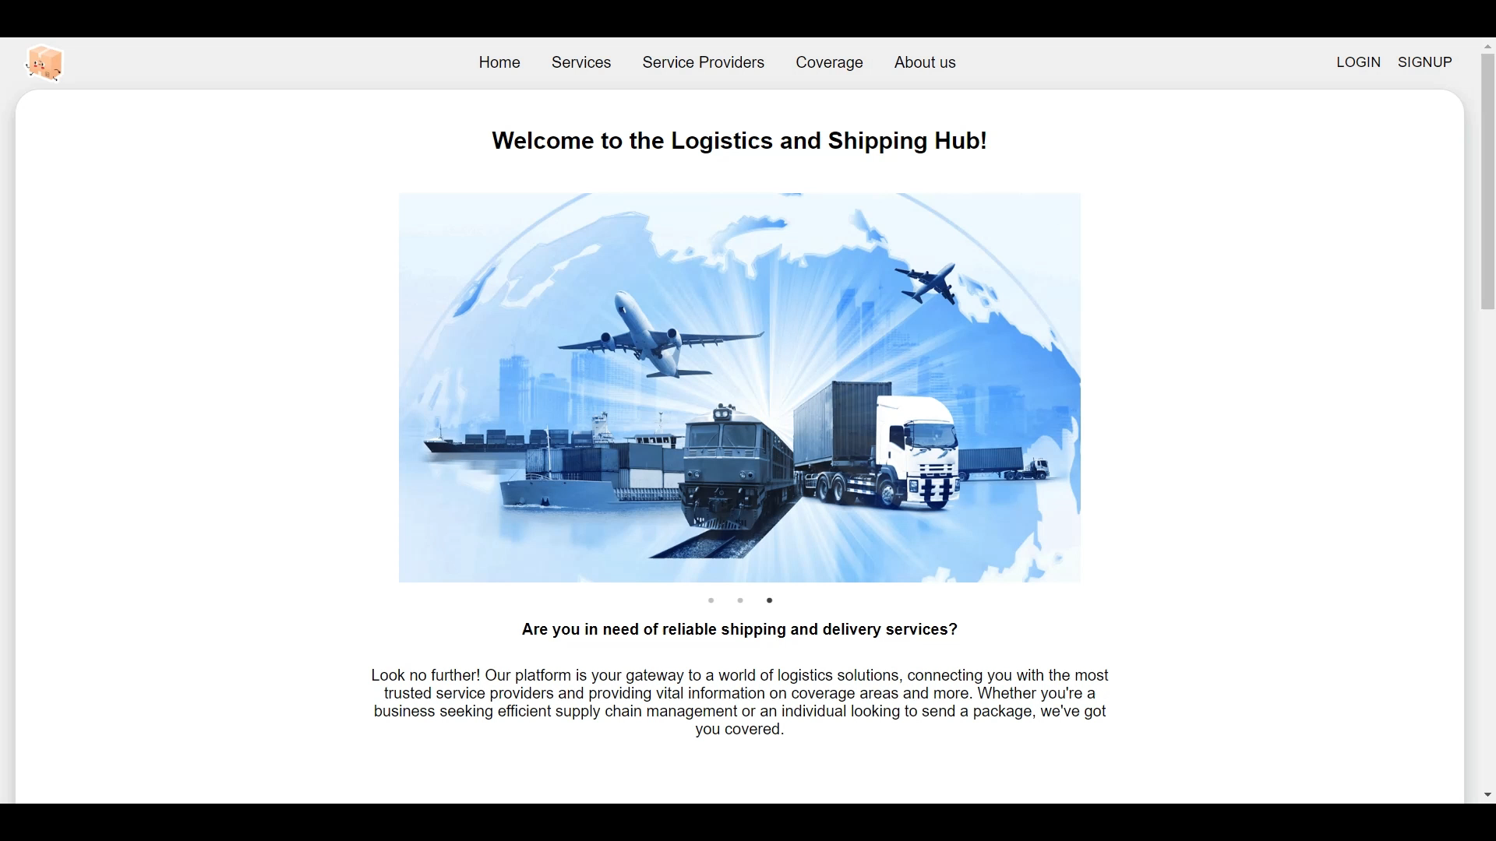
Demo

Slide 8

Thank you
Group No 14

